Slide 1
The Technology Value Stream
Mackenzie Lubben-Ortiz
WEB 430
21 March 2024

Slide 2
What is the Technology Value Stream?
The process required to convert a business hypothesis into a technology-enabled service or feature that delivers value to the customer
The sequence of activities necessary to deliver a product, service, or experience to a customer, internal or external
Cut across and connect siloed business capabilities
Provide end-to-end visibility of the activity flow, from customer request to delivery

Slide 3
What is Lead Time?
The amount of time that passes from the start of a process until its conclusion
Measures how long it takes to complete a process from beginning to end
Companies oftentimes review lead time during pre-processing, processing, and post-processing stages
To measure lead time, teams need to have a clear definition of when work begins and ends such as the measurable time between when a commit has been made, and the resulting code gets into production

Slide 4
What is Process Time?
The interval required for a product or service to progress through a specific development stage
Process times are directly related to throughput and profitability, so they are something businesses should always try to improve

Slide 5
Compare & Contrast
Lead time is one of two measures commonly used to measure performance in value streams, with the other being processing time (also referred to as touch or task time)
The lead time clock begins when a request is made and ends when it is fulfilled, while the process time clock starts when the work is begun on the customer request.

Slide 6
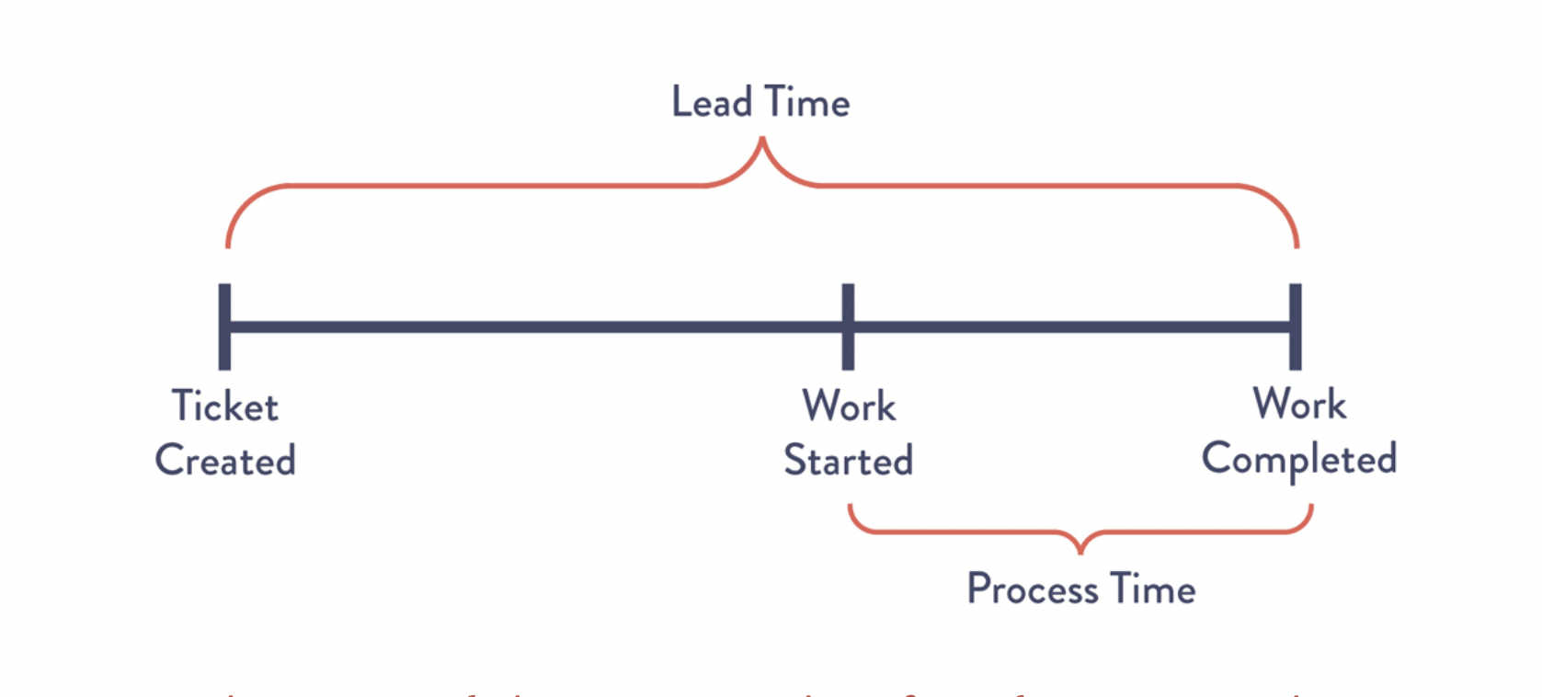
Lead Time vs. Process Time

Slide 7
The Common Scenario
When teams and organizations find themselves in situations where deployment lead times require months, heroics are required at almost every stage of the value stream.
There are many different outcomes such as discovering that nothing works at the end of the project when all the team changes are merged together, code that no longer builds correctly, or code that doesn’t pass any tests.
As a result, fixing each singular problem could require days or weeks of investigation to determine what’s broken, how it can be fixed, and oftentimes results in poor customer outcomes.

Slide 8
The DevOps Ideal
Developers receive fast, constant feedback on their work, enabling them to quickly implement, integrate, and validate their code
This is achieved by continuous checks on small code changes into the version control repository, performing automated testing against it, and deploying it into production

Slide 9
The DevOps Ideal cont.
Enables developers to have a high degree of confidence that changes will operate as designed in production and that any problems can be quickly detected and corrected
Strive for modular architecture:
Well encapsulated
Loosely coupled
In efforts that small teams are able to work with high degrees of autonomy, with failures being small and contained without causing global disruptions

Slide 10
Conclusion
In a project-based world, focus on efficiency is key
The point of value stream is to maximize the value over time
It’s critical now more than ever that software developers, testers and everyone involved do their best work
That being said, it’s essential for companies and developers to compose their processes to maximize their focus on value and to learn (or unlearn) habits that get in their way of successful development and deployment
The business world isn’t static--as a result, companies must continually improve their processes to maintain their profitability

